Slide 1
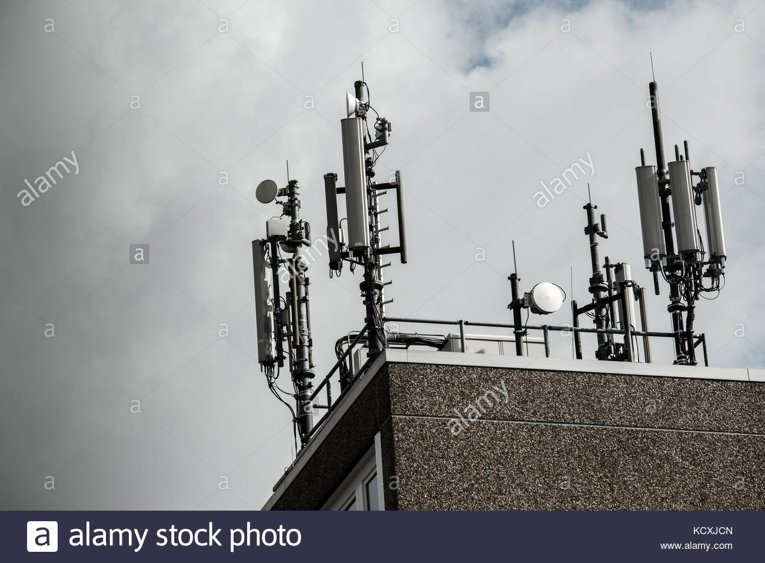


Slide 2
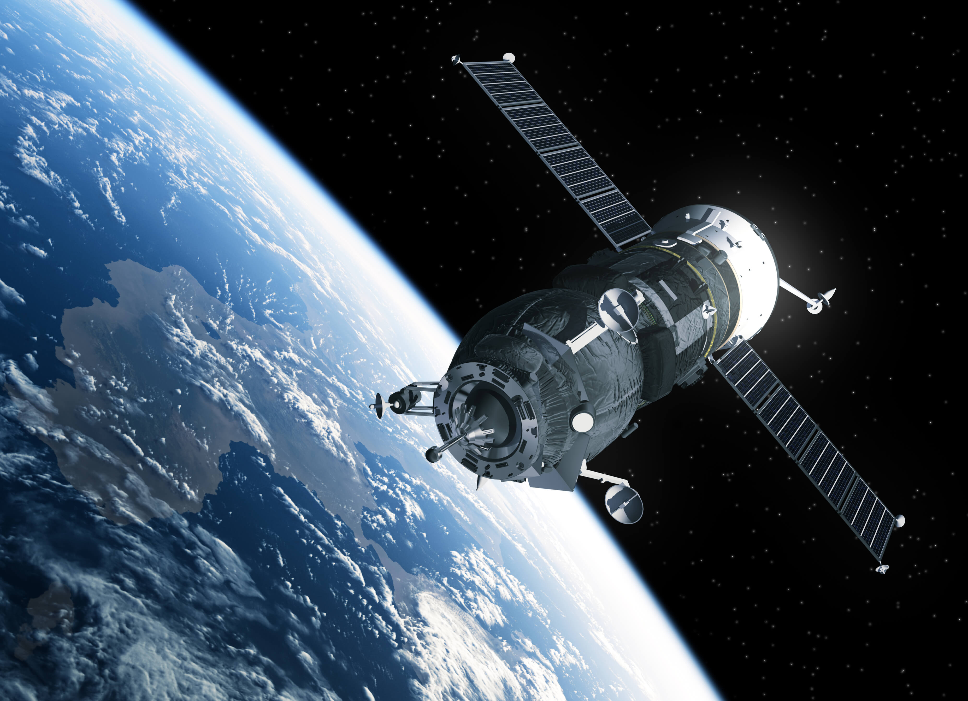

Slide 3


Slide 4
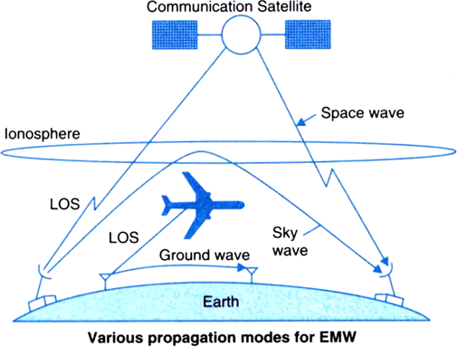

Slide 5
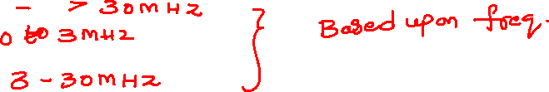
Radio Wave Propagation
In Radio communication systems, we use wireless electromagnetic waves as the channel. The antennas of different specifications can be used for these purposes. The sizes of these antennas depend upon the bandwidth and frequency of the signal to be transmitted.
The mode of propagation of electromagnetic waves in the atmosphere and in free space may be divided in to the following three categories −
Line of sight (LOS) propagation
Ground wave propagation
Sky wave propagation
In ELF (Extremely low frequency) and VLF (Very low frequency) frequency bands, the Earth, and the ionosphere act as a wave guide for electromagnetic wave propagation.
In these frequency ranges, communication signals practically propagate around the world. The channel band widths are small. Therefore, the information is transmitted through these channels has slow speed and confined to digital transmission.

Slide 6
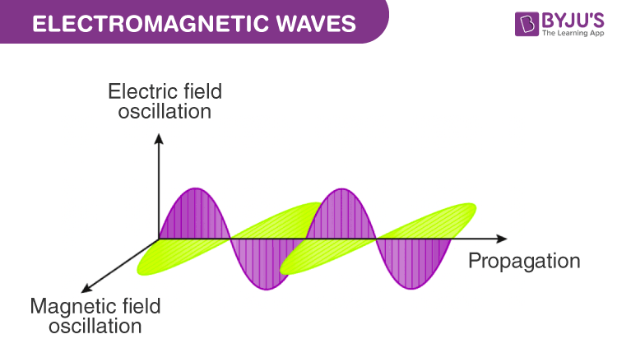
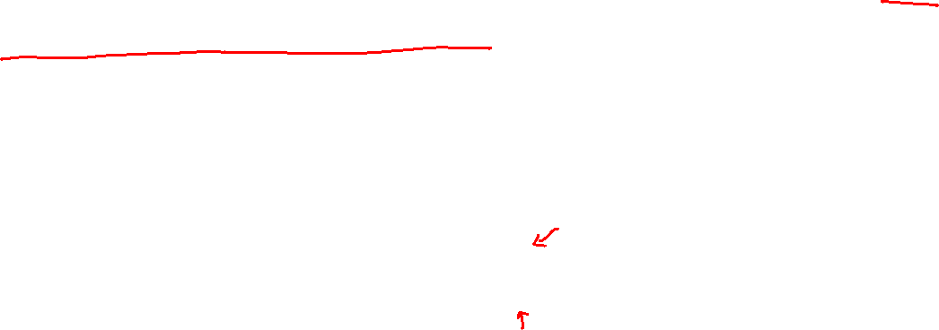
factors affecting radio wave propagation
As a form of electromagnetic radiation, like light waves, radio waves are affected by the phenomena of reflection, refraction, diffraction, absorption, polarization, and scattering.

Slide 7
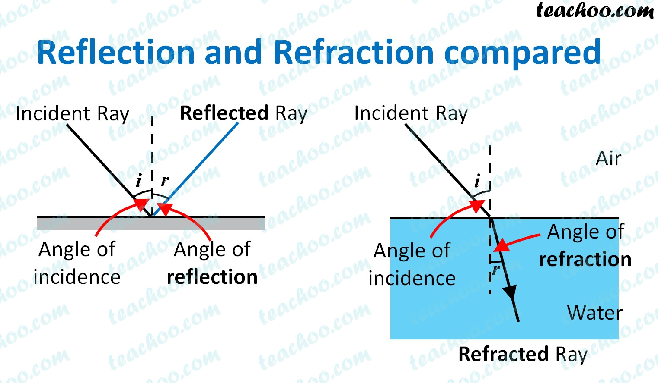
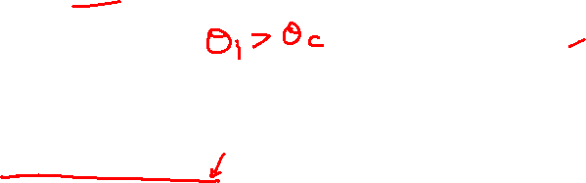

Slide 8
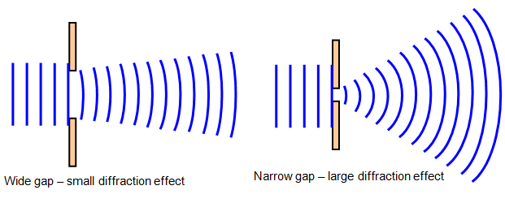
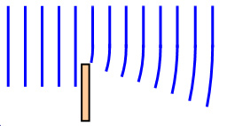
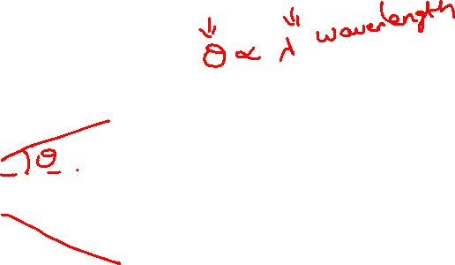

Slide 9
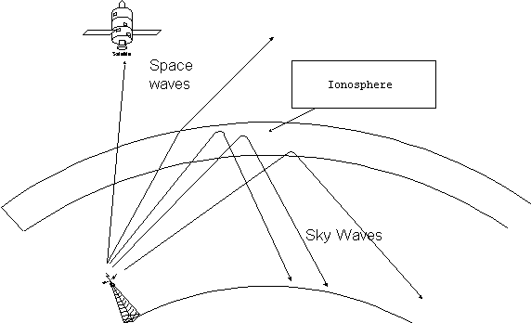

Slide 10
Line of Sight (LOS) Propagation
Among the modes of propagation, this line-of-sight propagation is the one, which we commonly notice. In the line-of-sight communication, as the name implies, the wave travels a minimum distance of sight. Which means it travels to the distance up to which a naked eye can see. Now what happens after that? We need to employ an amplifier cum transmitter here to amplify the signal and transmit again.

Slide 11
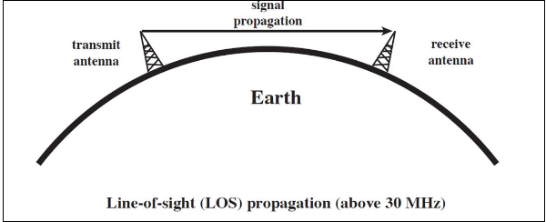

Slide 12
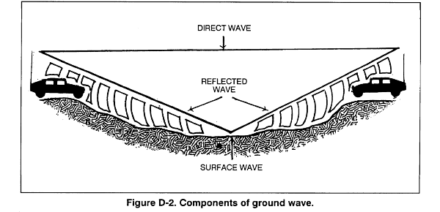
Ground Wave Propagation
Ground wave propagation of the wave follows the contour of earth. Such a wave is called as direct wave. The wave sometimes bends due to the Earth’s magnetic field and gets reflected to the receiver. Such a wave can be termed as reflected wave.

Slide 13
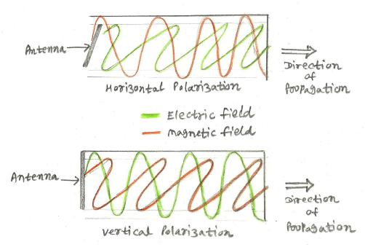

Slide 14
Orientation of electric and magnetic field vectors are very important in radio wave communication. The direction of electric field vector specifies polarization of the antenna. There are two types in linear polarization viz. horizontal and vertical.
In the horizontal polarization, electric field vector of EM(electro-magnetic) wave is parallel to the earth.This is generated by having antennas horizontal to the earth. The same is explained in the figure by showing electric field in the direction of propagation.
In the vertical polarization, electric field vector of EM(electro-magnetic) wave is perpendicular to the earth.This is generated by having antennas vertical to the earth. The same is explained in the figure by showing electric field in the perpendicular direction of propagation.
In order to make communication link work effectively, both transmitting and receiving antennas should be in the same polarization.

Slide 15
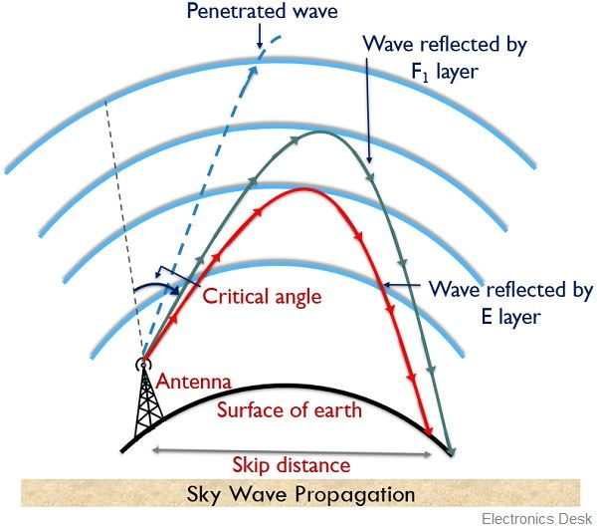

Sky Wave Propagation
Sky wave propagation is preferred when the wave has to travel a longer distance. Here the wave is projected onto the sky and it is again reflected back onto the earth.

Slide 16
The sky wave propagation is well depicted in the above picture. Here the waves are shown to be transmitted from one place and where it is received by many receivers. Hence, it is an example of broadcasting.
The waves, which are transmitted from the transmitter antenna, are reflected from the ionosphere. It consists of several layers of charged particles ranging in altitude from 30- 250 miles above the surface of the earth. Such a travel of the wave from transmitter to the ionosphere and from there to the receiver on Earth is known as Sky Wave Propagation. Ionosphere is the ionized layer around the Earth’s atmosphere, which is suitable for sky wave propagation.

Slide 17
Earth’s atmosphere has several layers. These layers play an important role in the wireless communication. These are mainly classified into three layers.
Troposphere
This is the layer of the earth, which lies just above the ground. We, the flora and fauna live in this layer. The ground wave propagation and LOS propagation take place here.
Stratosphere
This is the layer of the earth, which lies above Troposphere. The birds fly in this region. The airplanes travel in this region. Ozone layer is also present in this region. The ground wave propagation and LOS propagation takes place here.
Ionosphere
This is the upper layer of the Earth’s atmosphere, where ionization is appreciable. The energy radiated by the Sun, not only heats this region, but also produces positive and negative ions. Since the Sun constantly radiates UV rays and air pressure is low, this layer encourages ionization of particles.

Slide 18
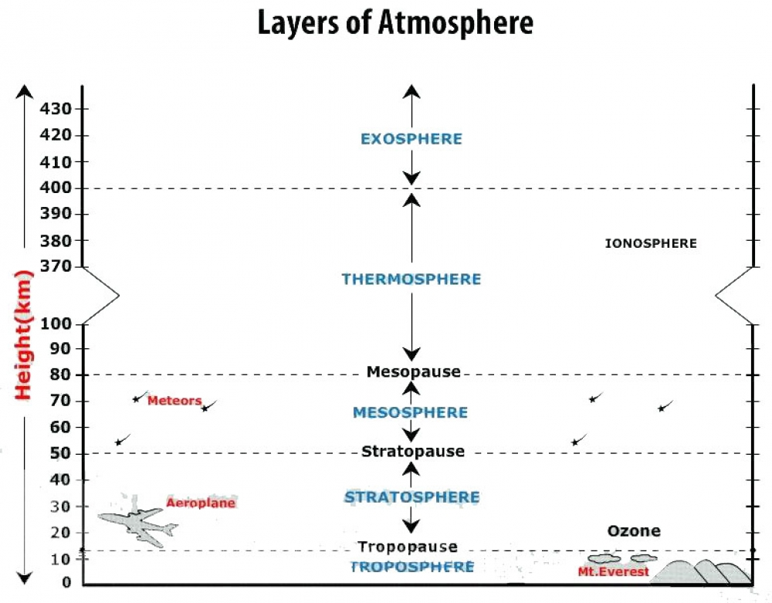
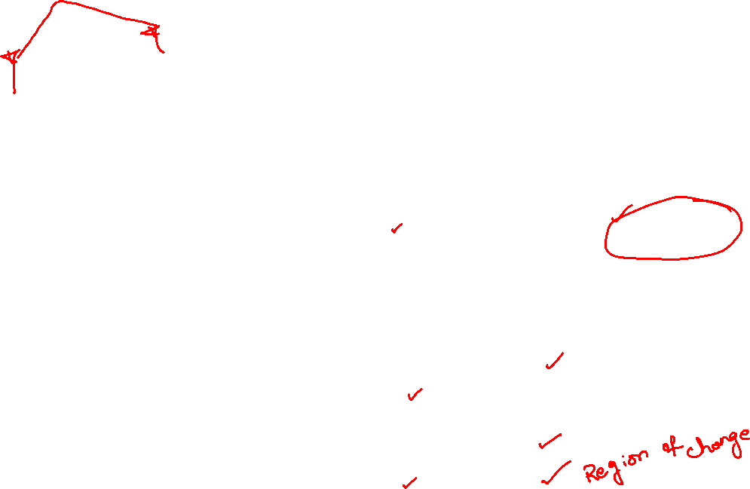

Slide 19
Importance of Ionosphere
The ionosphere layer is a very important consideration in the phase of wave propagation because of the following reasons −
The layer below ionosphere has higher amount of air particles and lower UV radiation. Due to this, more collisions occur and ionization of particles is minimum and not constant.
The layer above ionosphere has very low amount of air particles and density of ionization is also quite low. Hence, ionization is not proper.
The ionosphere has good composition of UV radiation and average air density that does not affect the ionization. Hence, this layer has most influence on the Sky wave propagation.
The ionosphere has different gases with different pressures. Different ionizing agents ionize these at different heights. As various levels of ionization are done at each level, having different gases, few layers with different properties are formed in the ionosphere.

Slide 20
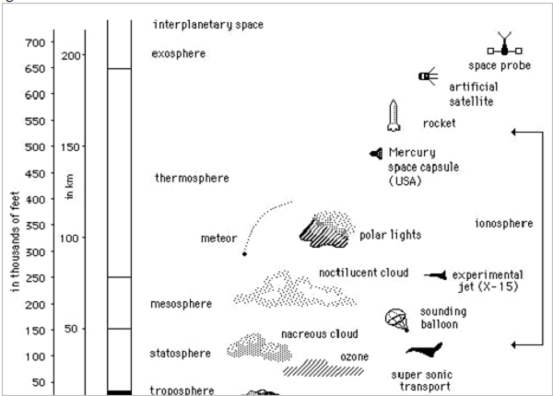
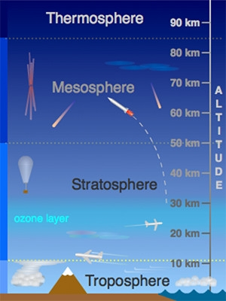

Slide 21
The number of layers, their heights, the amount of sky wave that can be bent will vary from day to day, month to month and year to year. For each such layer, there is a frequency, above which if the wave is sent upward vertically, it penetrates through the layer.
The function of these layers depends upon the time of the day, i.e., day time and night time. There are three principal layers- E, F1 and F2 during day time. There is another layer called D layer, which lies below E layer. This layer is at 50 to 90kms above the troposphere.
The following figure depicts the layers present in both day time and night time in the earth’s atmosphere.

Slide 22
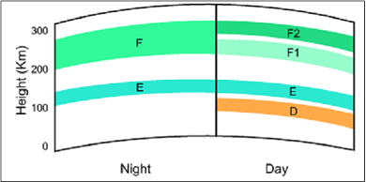

This D layer is responsible for the day time attenuation of HF waves. During night time, this D layer almost vanishes out and the F1 and F2 layers combine together to form F layer. Hence, there are only two layers E and F present at the night time.

Slide 23
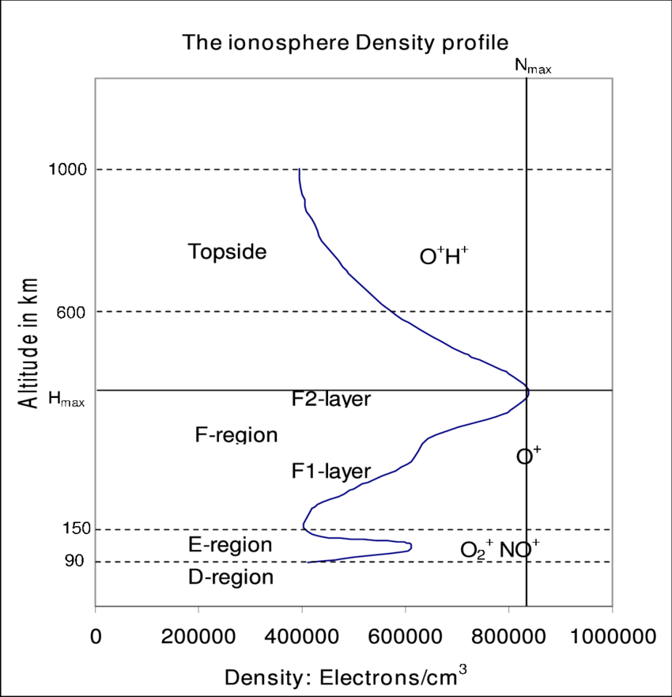
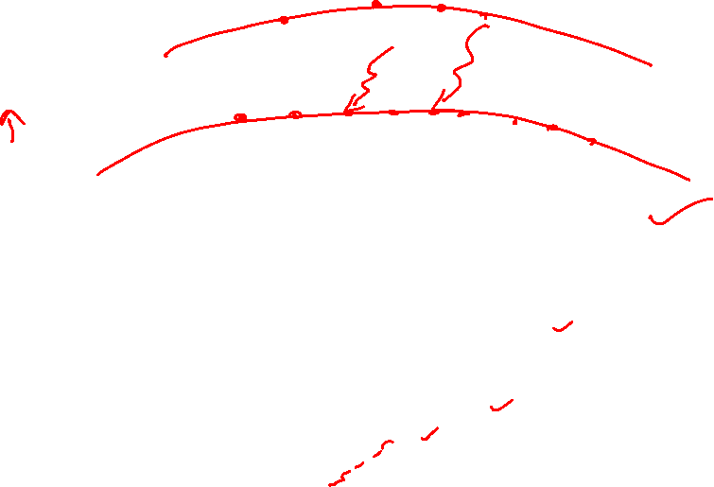

Slide 24
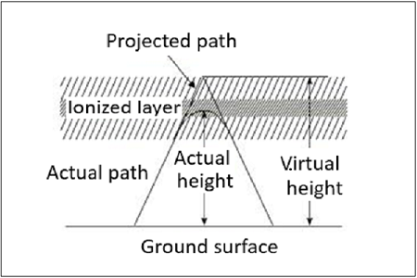
Virtual Height
When a wave is refracted, it is bent down gradually, but not sharply. However, the path of incident wave and reflected wave are same if it is reflected from a surface located at a greater height of this layer. Such a greater height is termed as virtual height.
The figure clearly distinguishes the virtual height (height of wave, supposed to be reflected) and actual height (the refracted height). If the virtual height is known, the angle of incidence can be found.

